Slide 1
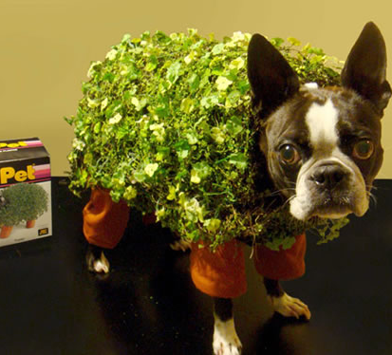
Monday, November 28, 2022
Take a Chia Pet packet
Write your name, section, and table fruit on the front of the packet.
This Photo by Unknown Author is licensed under CC BY-SA-NC

Slide 2
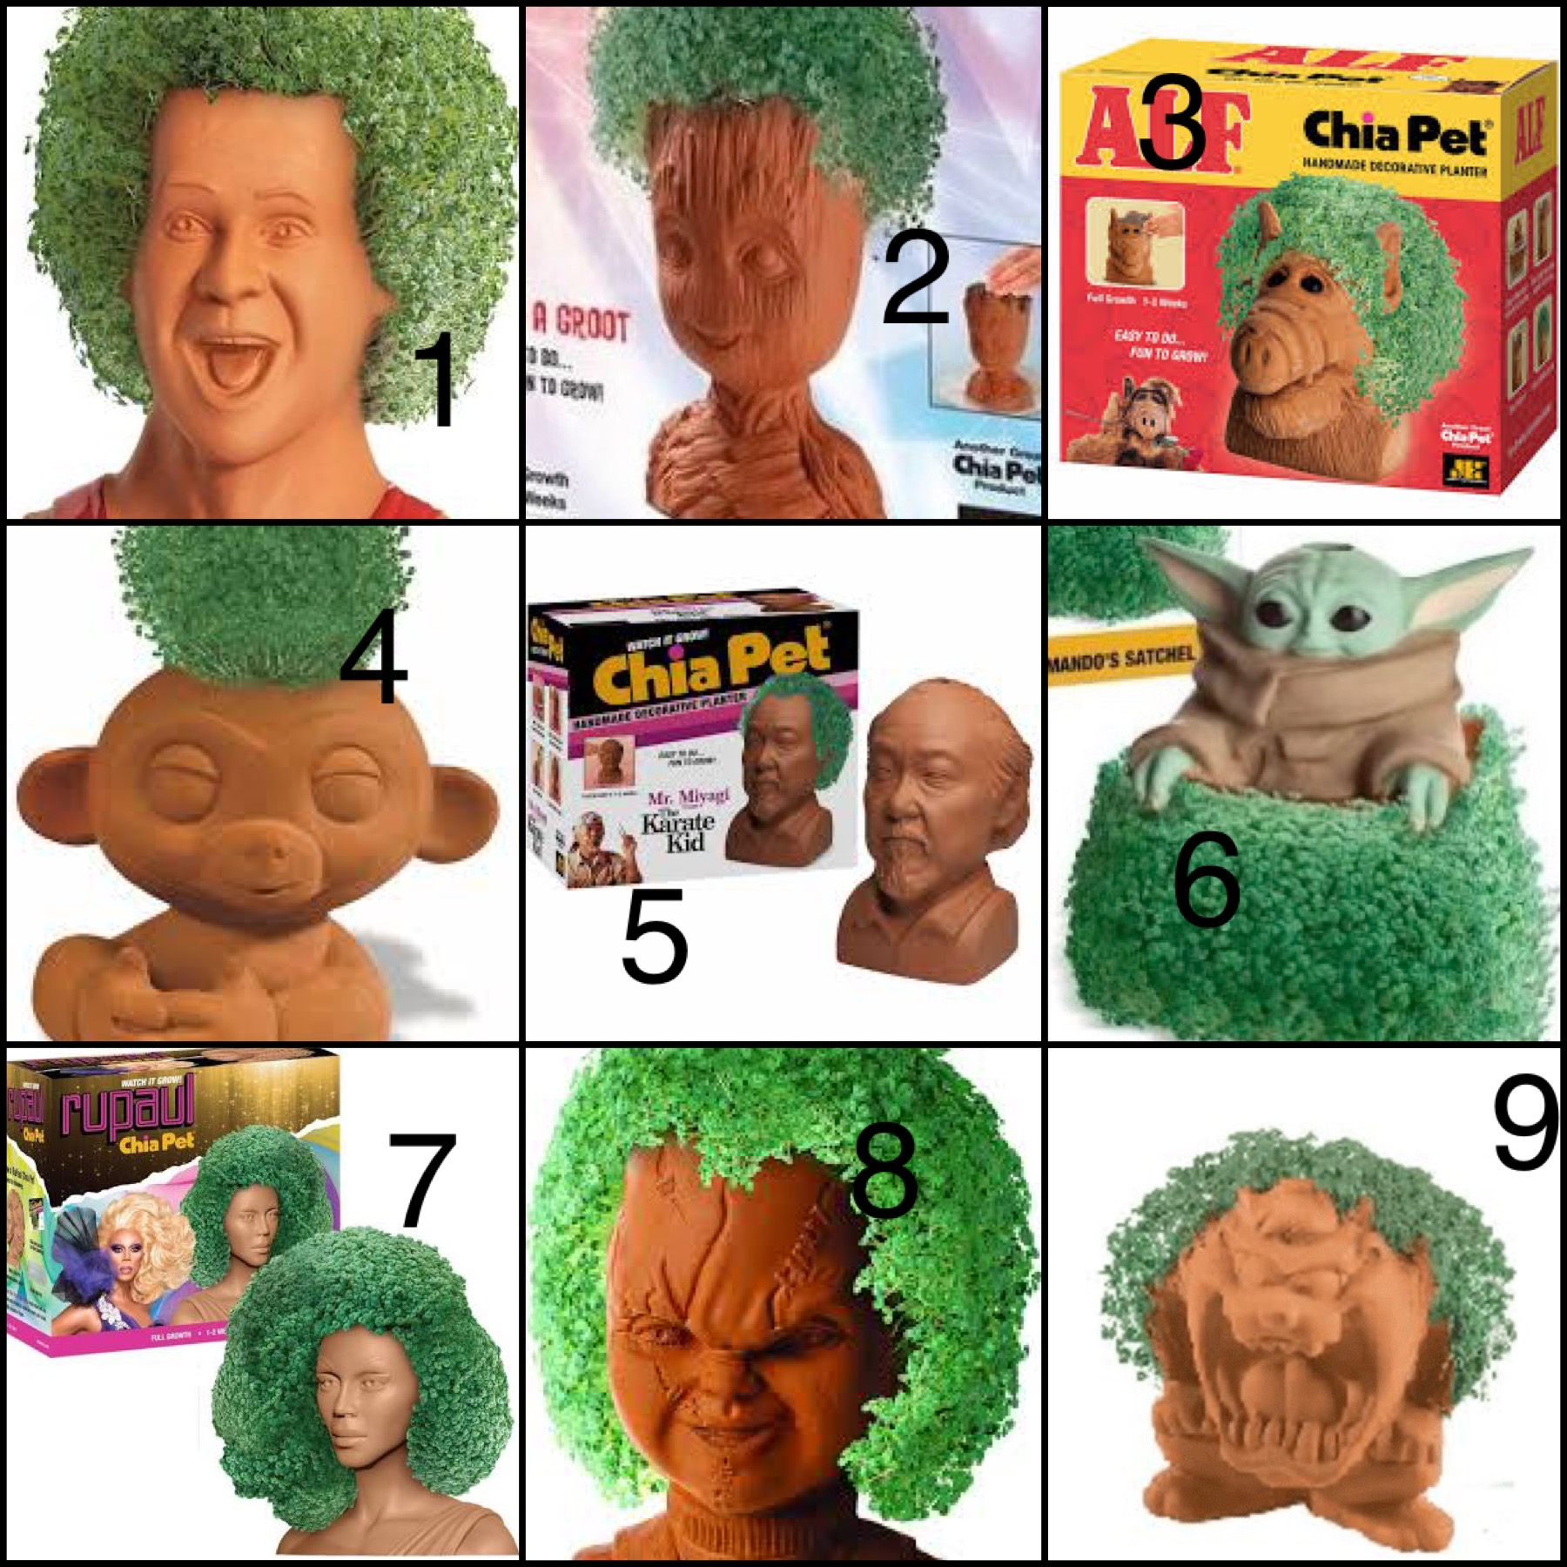
Chia Pets
Ch Ch Ch Chia

Slide 3
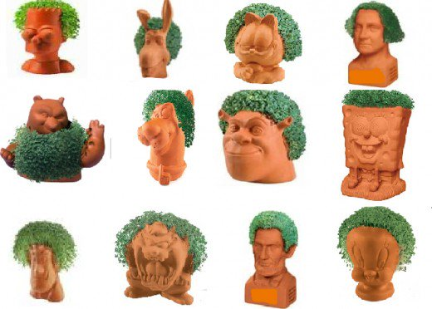
Chia Commercial
https://youtu.be/2eC4V77cjzI

Slide 4
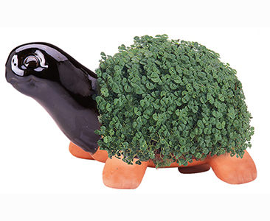
What is a Chia Pet?
https://chia.com/chia-pets/
Chia Pets are American styled terracotta figurines used to sprout chia, where the chia sprouts grow within a couple of weeks to resemble the animal's fur or hair. Moistened seeds of chia (Salvia hispanica) are applied to the grooved terra cotta figurine body.

Slide 5
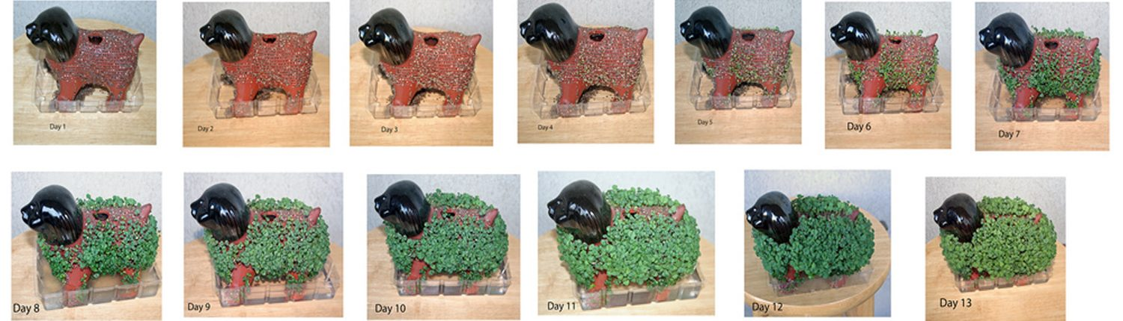
Marketed by Joe Pedott and produced by San Francisco, California-based company Joseph Enterprises, Inc., the first Chia Pet, Chia Guy was created on September 8, 1977. A trademark registration was filed on Monday, October 17, 1977. Pedott first learned about Chia Pets when he attended a housewares show in Chicago in 1977. Chia Pets achieved popularity in the 1980s following the 1982 release of a ram, the first widely marketed Chia Pet.
https://chia.com/chia-pets/about-chia-pets/

Slide 6
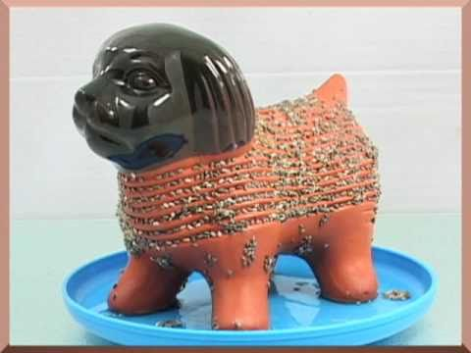
Anatomy of a Chia Pet
_____________________
______________________________
____________________________
______________________________

Slide 7
Anatomy of a Chia Pet
Hollow “bowl” for water
Water Hole
Grooves for Seeds
Water Catcher

Slide 8
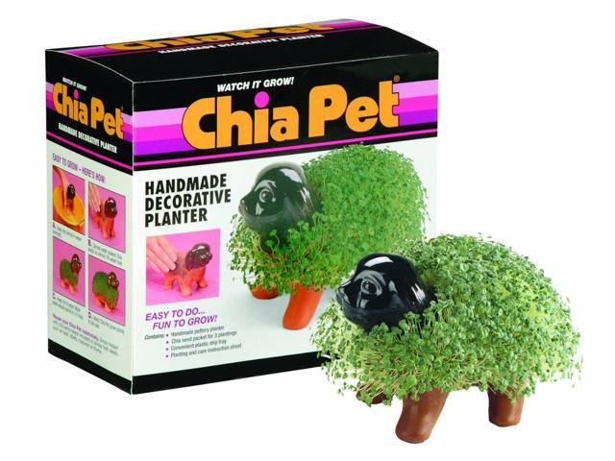

Slide 9
Your Chia Pet
The sculpture must include:
*Chia Pet theme: Chesapeake Bay Life
*The sculpture is an animal native to the Chesapeake Bay region..
*Specific details making the animal recognizable including proportions, shape, and texture.
*The water catcher plate is sculpted as the animal’s natural habitat.

Slide 10
Designing a Inspired Chia Pet
Design Requirements:
Hollow bowl to hold water where the plant will grow
Grooves for seeds around the hollow area.
Hole at the top of the water area to add water.
Water Catcher below the water area designed as the animal’s natural habitat.

Slide 11
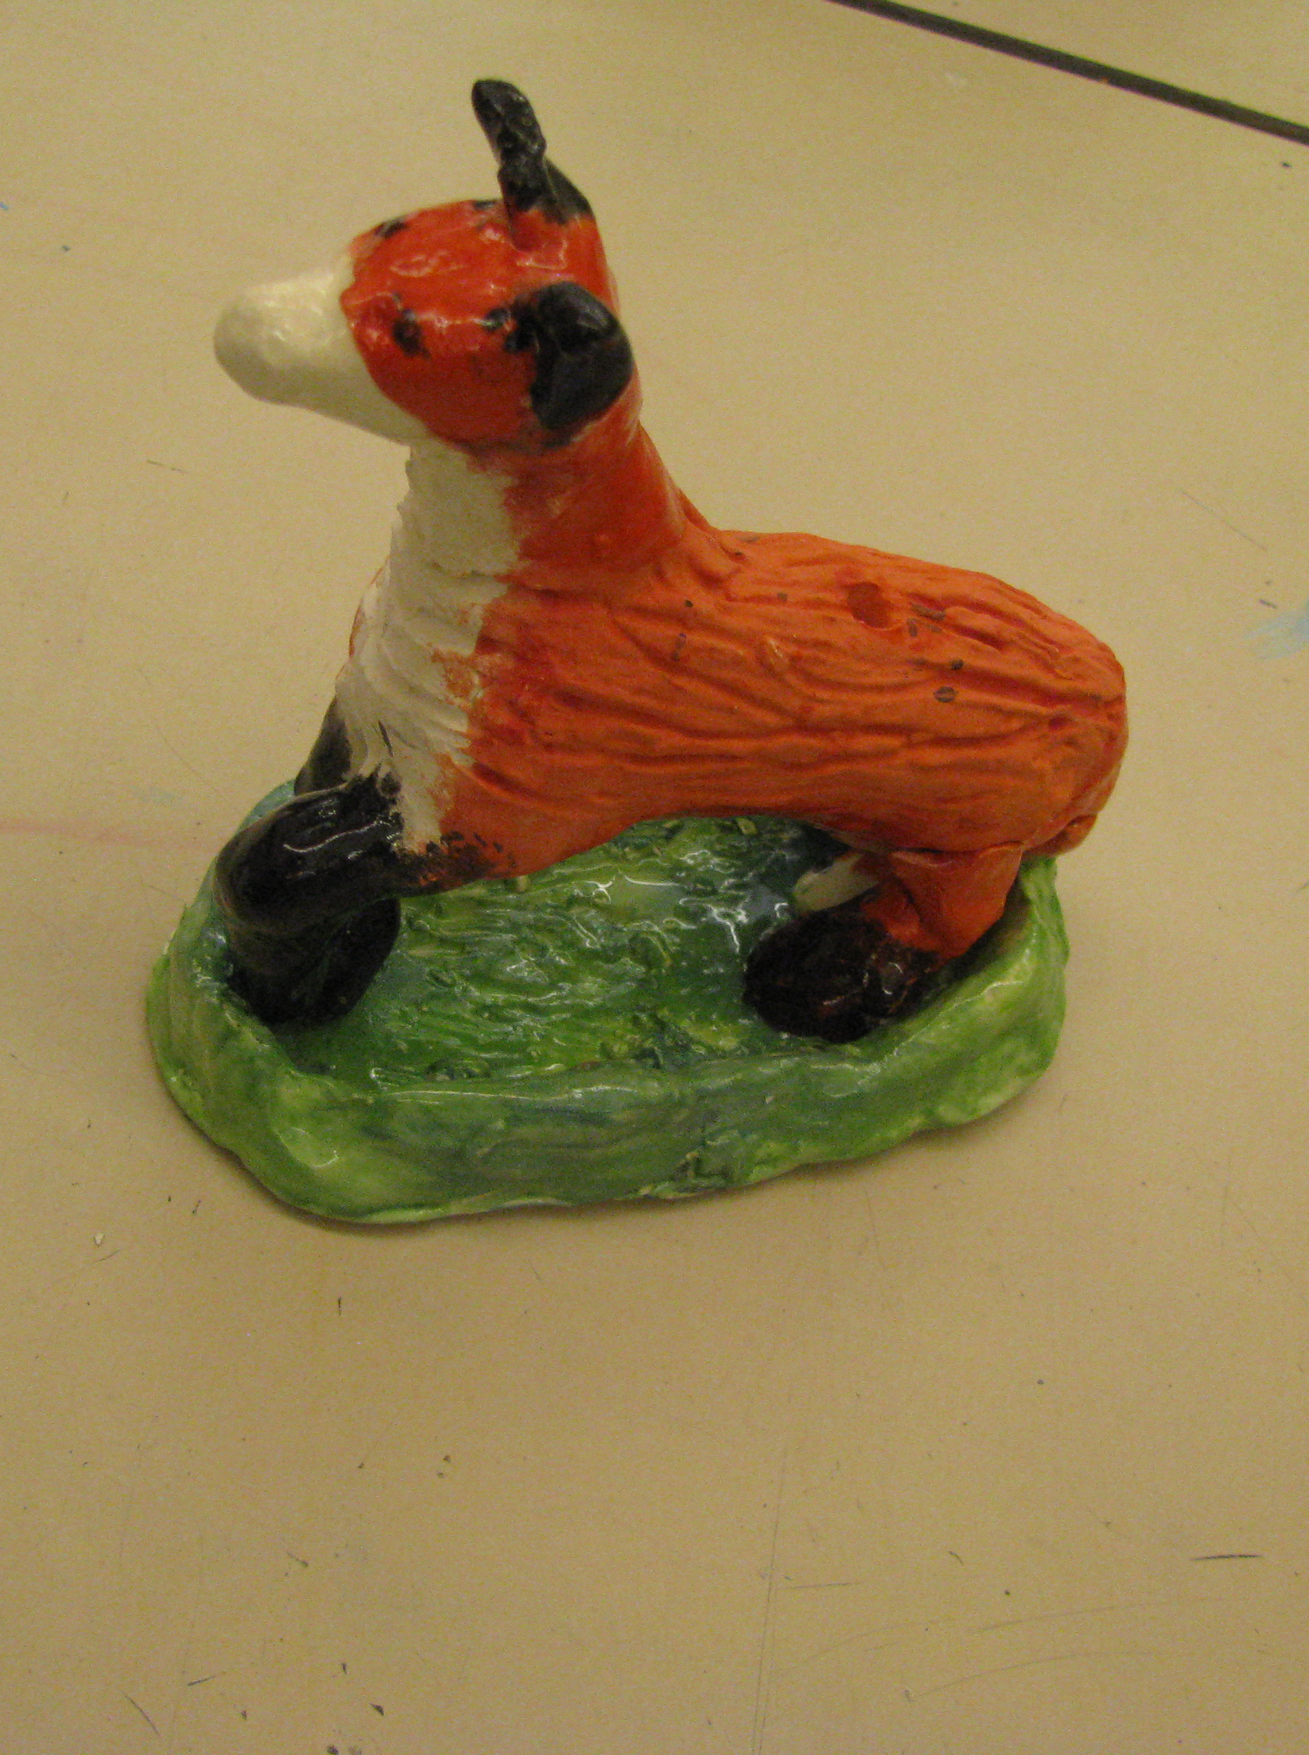
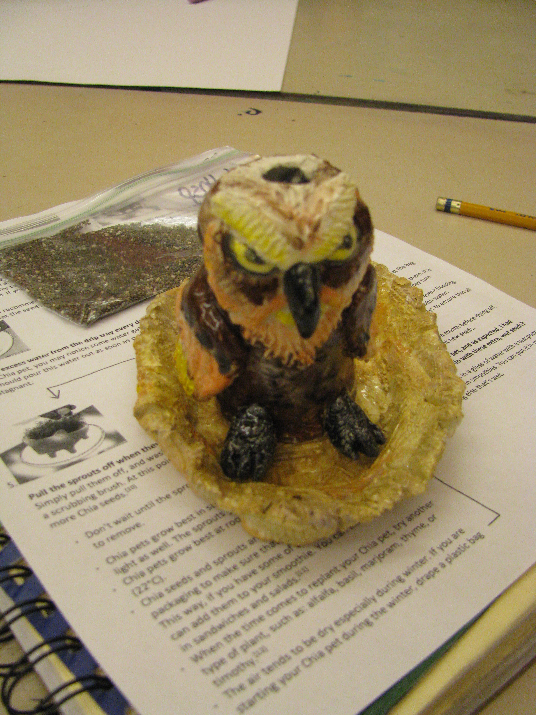
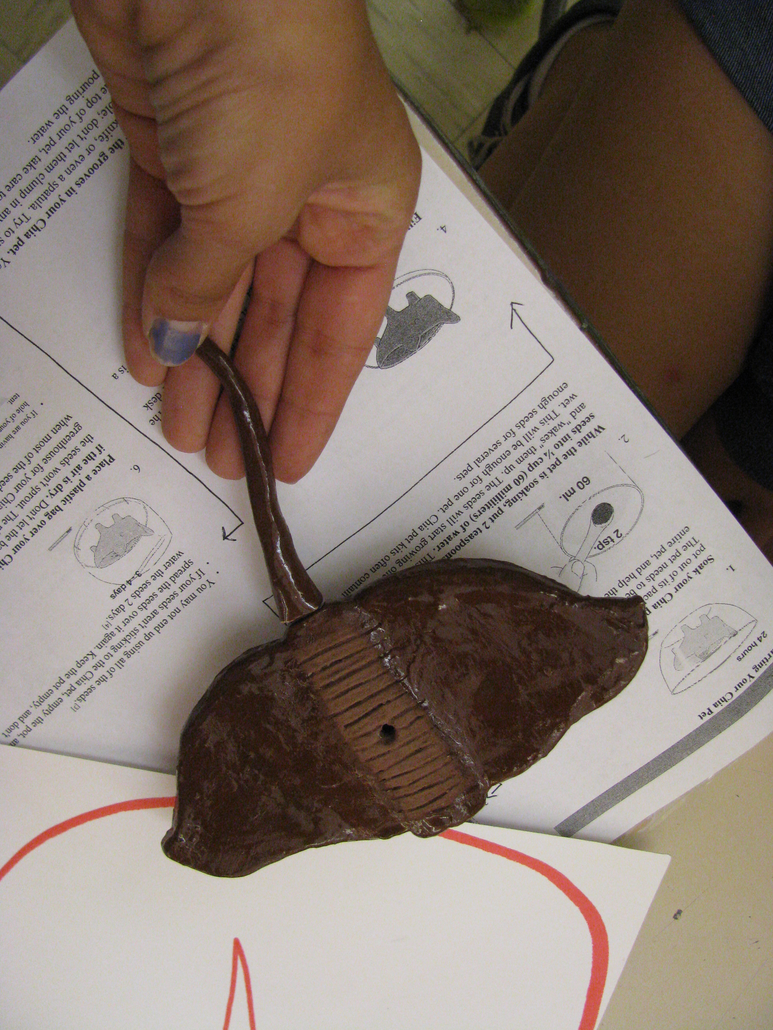
Some ideas from past years

Slide 12
Research
Complete and submit your mixed media self portrait and reflection questions.
Begin your research using the Chesapeake Bay Fact file assignment. Submit your file.
Begin your design plan based on your research. Submit your design plan.
8th Grade Shirt Design
Double check that all assignments on your grade sheet are complete and submitted.

Slide 13
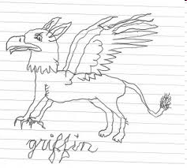
Why does this picture
NOT
meet the criteria?

